Slide 1
Guide Dog for Ros2
전찬욱 한상훈 류지형

Slide 2
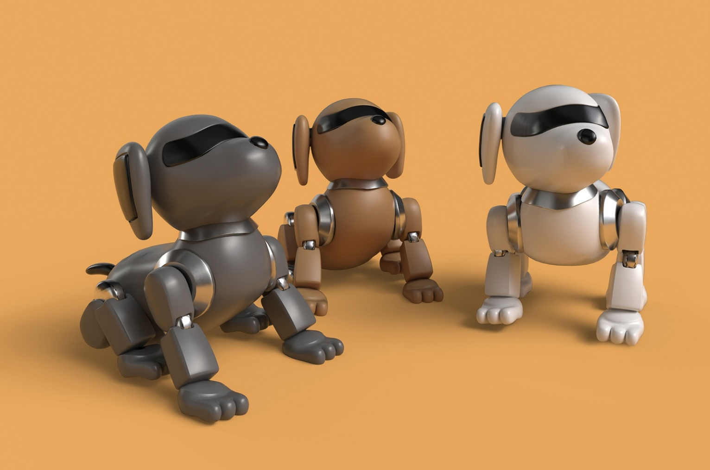
Contents
1. Quadrupedal Robot
2. Guide Dog
3. Project

Slide 3
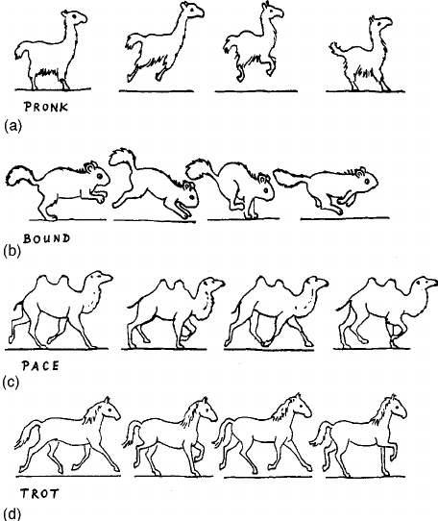
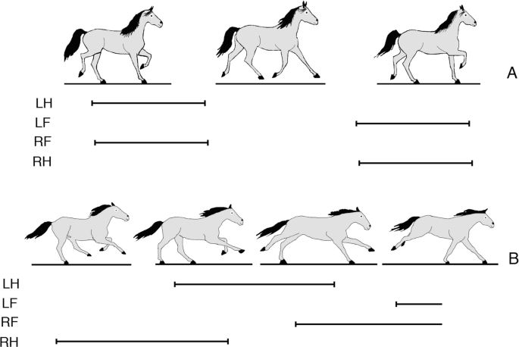
Quadrupedal Robot
Basic Model

Slide 4

Guide Dog
연간 4만 달러의 비용 소요
평균 2년이란 훈련 시간 필요
알레르기 등 제한적 상황 존재
유지 비용 부담

Slide 5
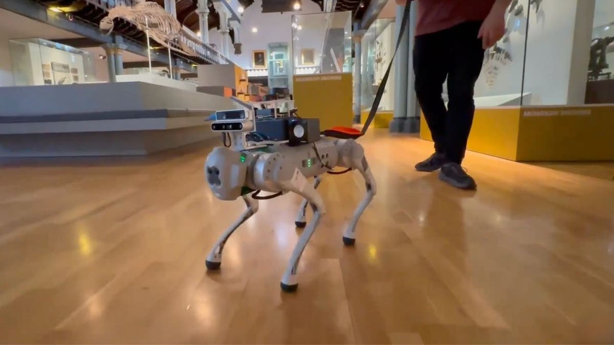
Robot Guide Dog
대량 생산성
구매 비용 및 유지 비용 완화
환경 변화에 대한 빠른 적응
양방향 통신 가능

Slide 6
Project
Robot + Guide Dog
Low Level
Controller
Motor Control
(PD Controller)
동작 패턴을 모터 신호로 변환
Low Level Policy
Position/Velocity Control
LLC와 HLC 사이에서 기본적인 동작 패턴 생성
High Level
Controller
Traffic Light
사람에게 편의를 주는 기능을 구현
Path Planning
Traffic Light Detection
Obstacle/Hazard Avoidance
Surface
Classification
Obstacle
Avoidance

Slide 7
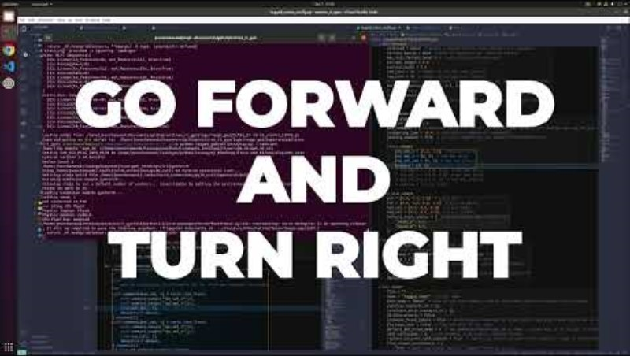
Project
Simulation

Slide 8
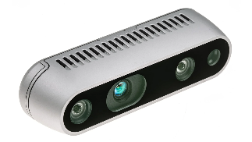
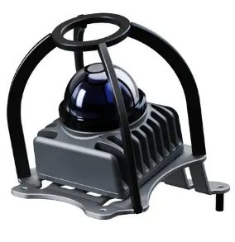
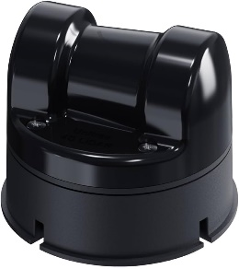
Project
Pipeline
Perception
Motion planning
Segmentation
Driver
Interface
Detection
Velocity
Replanner
Classification
LiDAR Object
Detection
Obstacle
Avoidance
Deep
Learning
Based Path
Follower
A*
Algorithm
SLAM
3D Map Generation
Waypoint
Generation
PD Control
Encoder
Localization

Slide 9
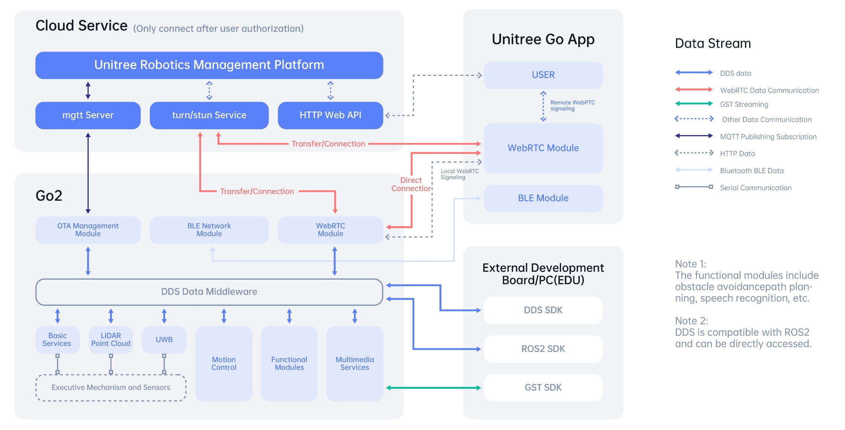
Project

Slide 10

Project
Sensor
https://github.com/IntelRealSense/realsense-ros
/color/camera_info
/color/image_raw
/color/metadata
/depth/camera_info
/depth/image_rect_raw
/depth/metadata/
/extrinsics/depth_to_color
/imu
Intel D435i

Slide 11
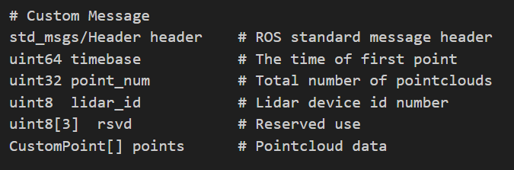

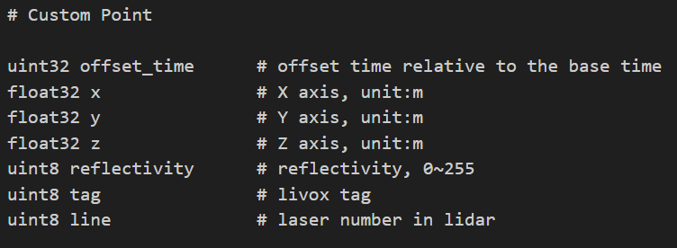
Project
Sensor
https://github.com/Livox-SDK/livox_ros_driver2
Unitree Mid-360

Slide 12

Project
Sensor
https://github.com/unitreerobotics/unilidar_sdk?tab=readme-ov-file
The defalut cloud topic and its frame name is:
topic: "unilidar/cloud"
frame: "unilidar_lidar"
The defalut IMU topic and its frame name is:
topic: "unilidar/imu"
frame: "unilidar_imu"
Intel D435i

Slide 13
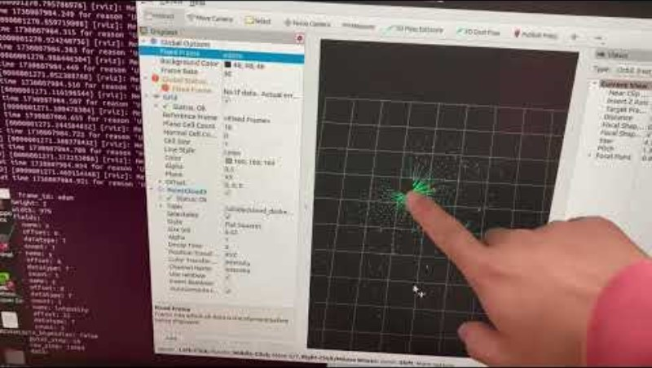
Project
Point Cloud Visualization

Slide 14
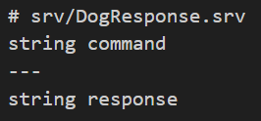
Project
Service (1)
voice_command_client
interaction_client
command
response
command
response
dog_response_server
dog_behavior_server

Slide 15
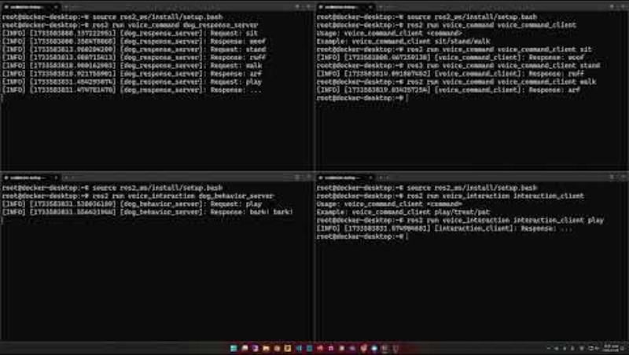
Project
Service (1)

Slide 16
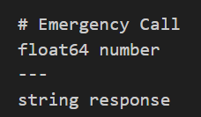
Project
Service (2) – Emergency Call
Emergency_client
number
response
Emergency_response

Slide 17
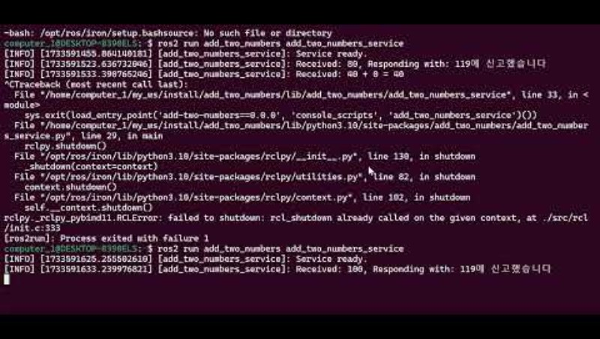
Project
Service (2) – Emergency Call

Slide 18
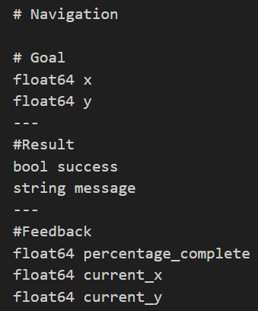
Project
Action
navigation_client
goal
navigation_server
cancel
status
result
feedback

Slide 19
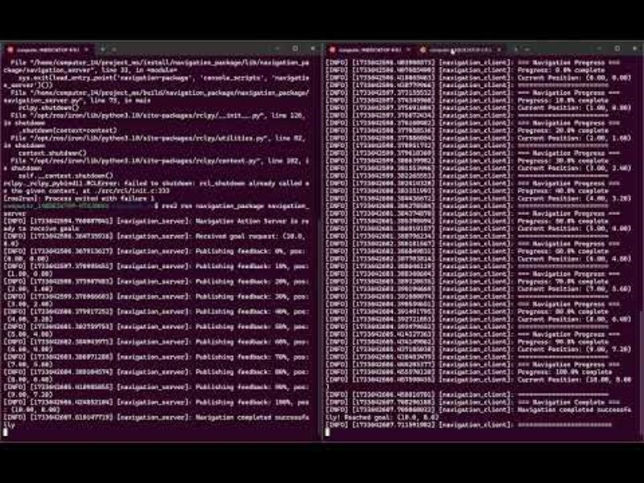
Project
Action

